Slide 1
Proposal Manager & Dynamics 365 for Sales
Integration Capabilities

Slide 2
Opportunity Creation
Create an Opportunity in Dynamics 365 for Sales and see the result in Proposal Manager

Slide 3
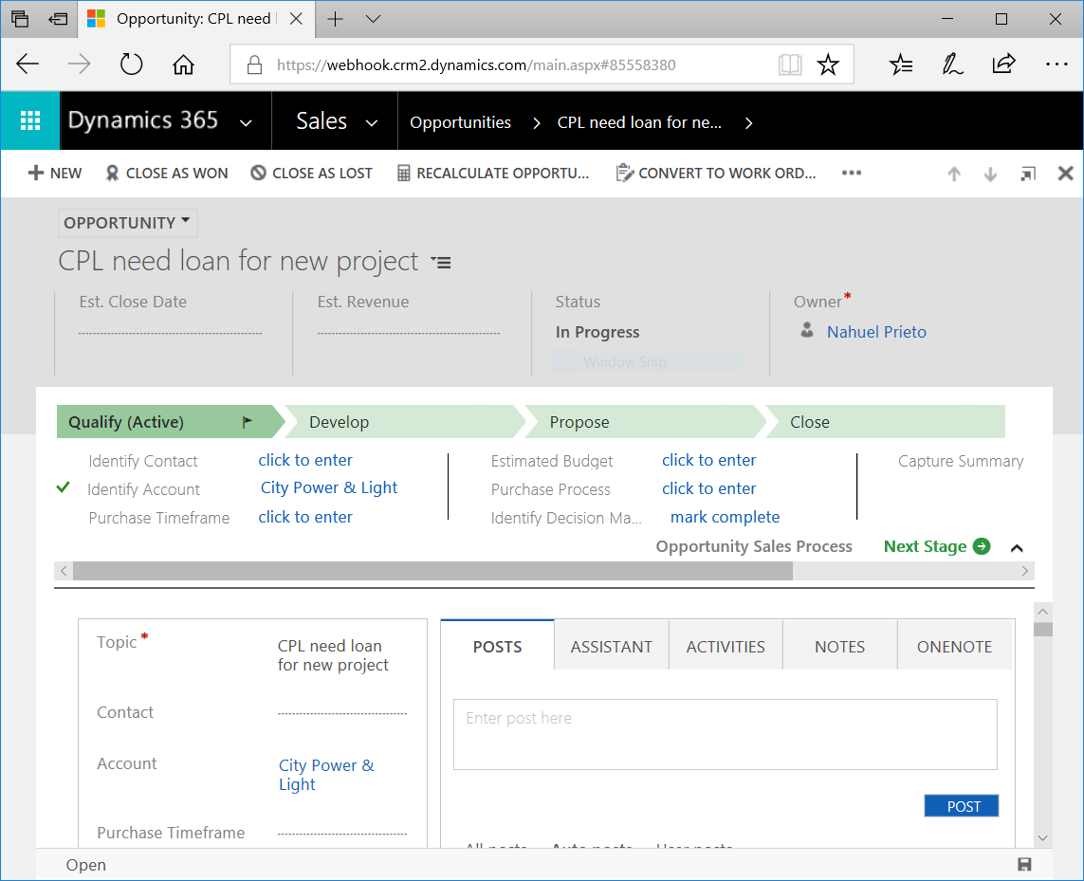
Create in Dynamics
Create the opportunity in Dynamics 365

Slide 4
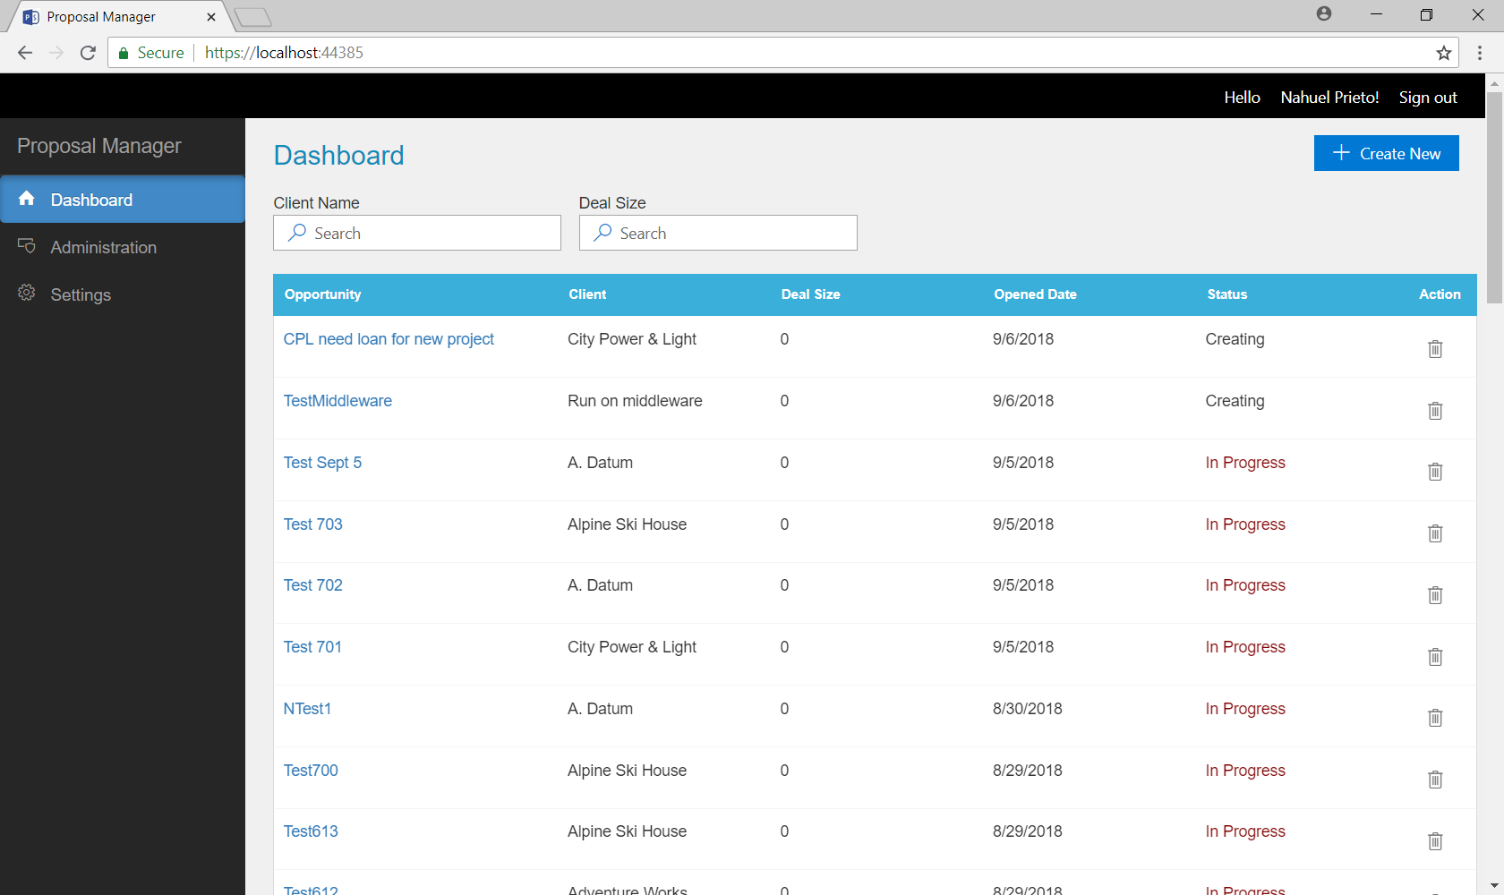
Visualize in Proposal Manager
Visualize the just created opportunity in Proposal Manager.

Slide 5
Adding attachments
Add an attachment to the opportunity, right from Dynamics 365

Slide 6
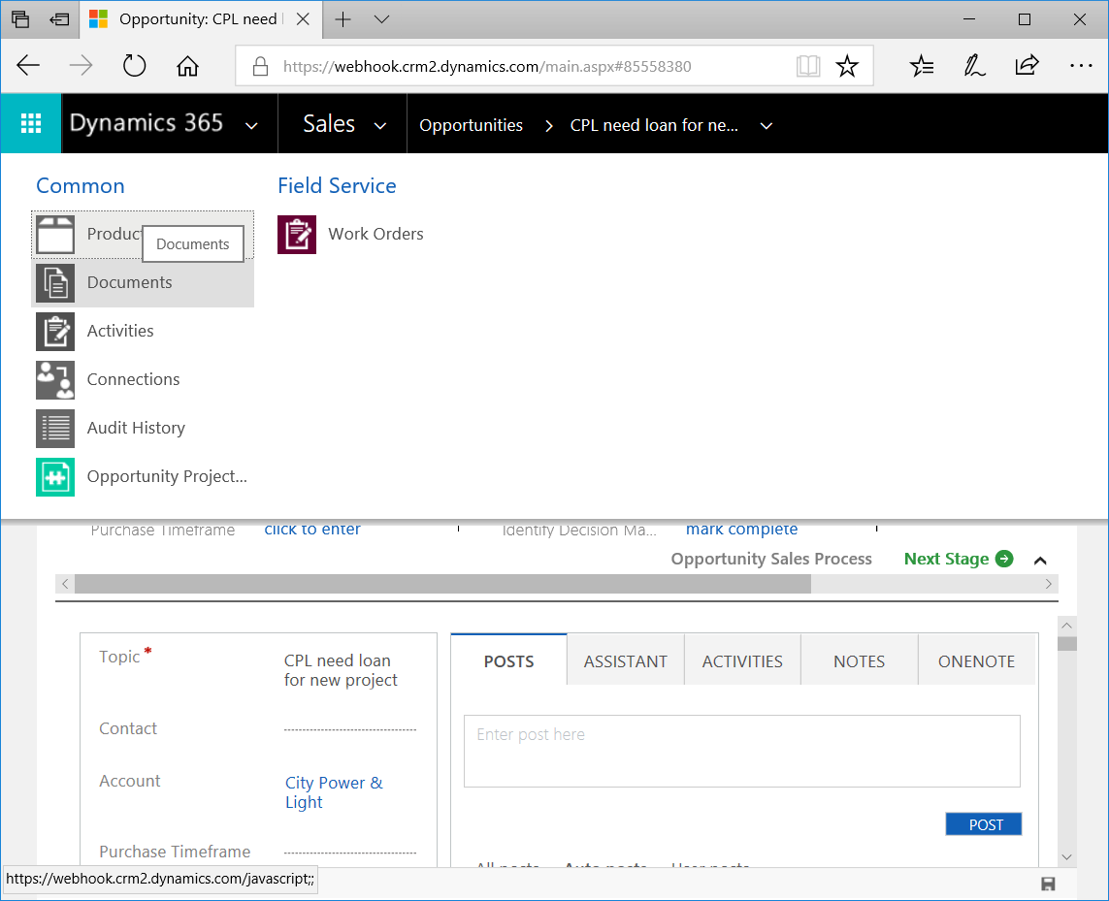
Go to “Documents”
In the top navigation bar, go to “Documents”, as shown in the picture.

Slide 7
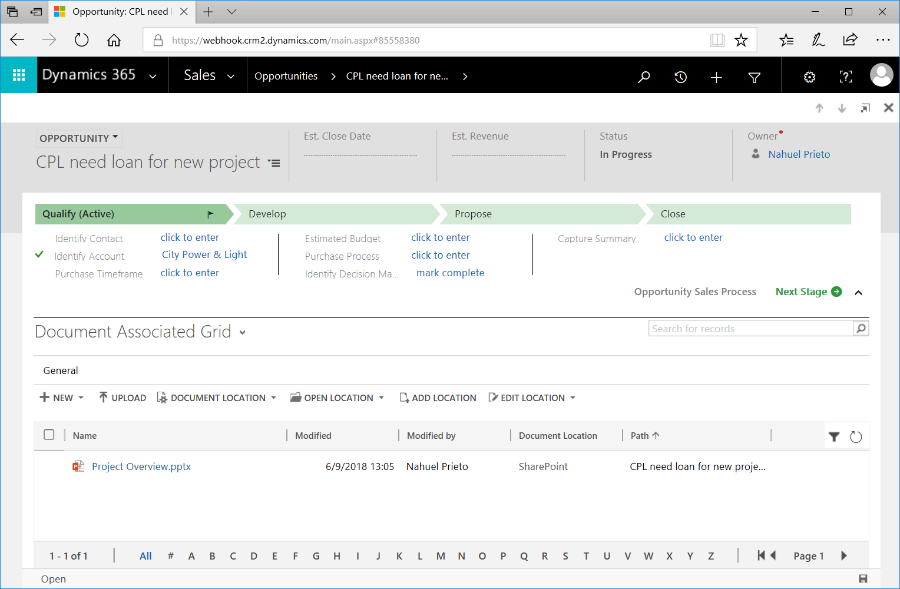
Add the attachment
From the documents grid, add the attachment that you want to associate to the opportunity, by either uploading it or creating it.

Slide 8
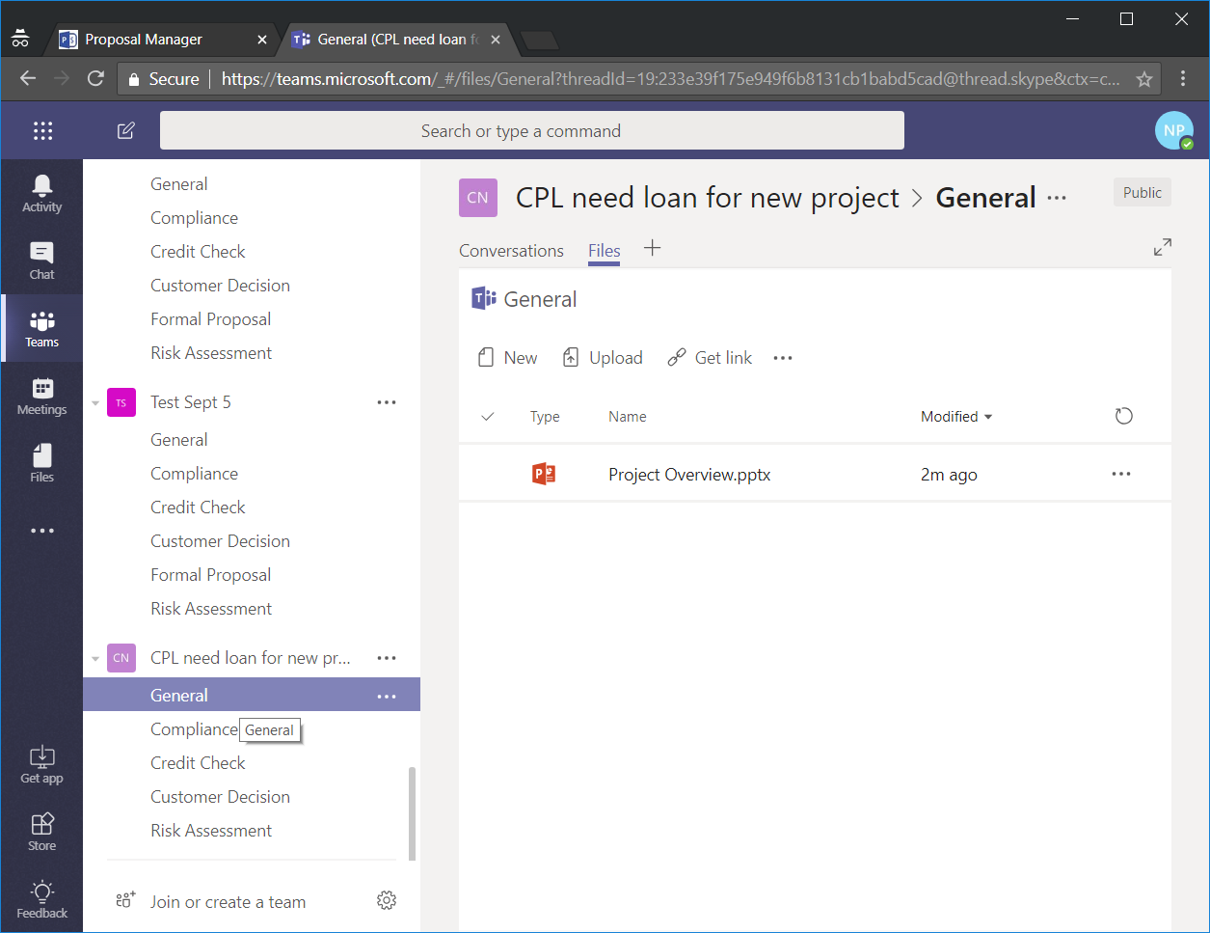
Visualize in Microsoft Teams
One the administrator has created the team, you can visualize the attachments in the Files tab of the General channel of the Team associated to the opportunity.

Slide 9
Adding Team Members
Add a member to the proposal management team, right from Dynamics 365

Slide 10
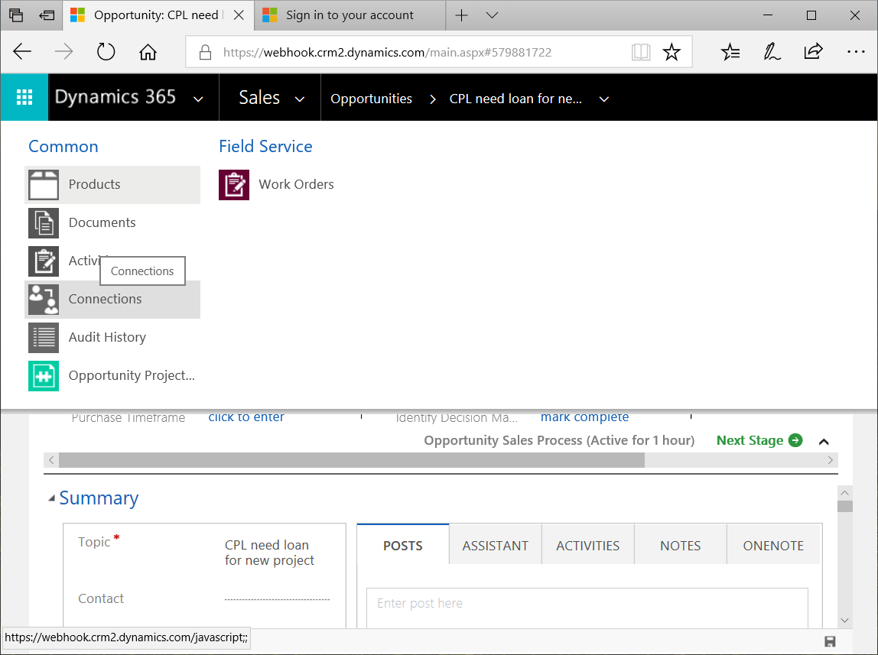
Go to “Connections”
In the top navigation bar, go to “Connections”, as shown in the picture.

Slide 11
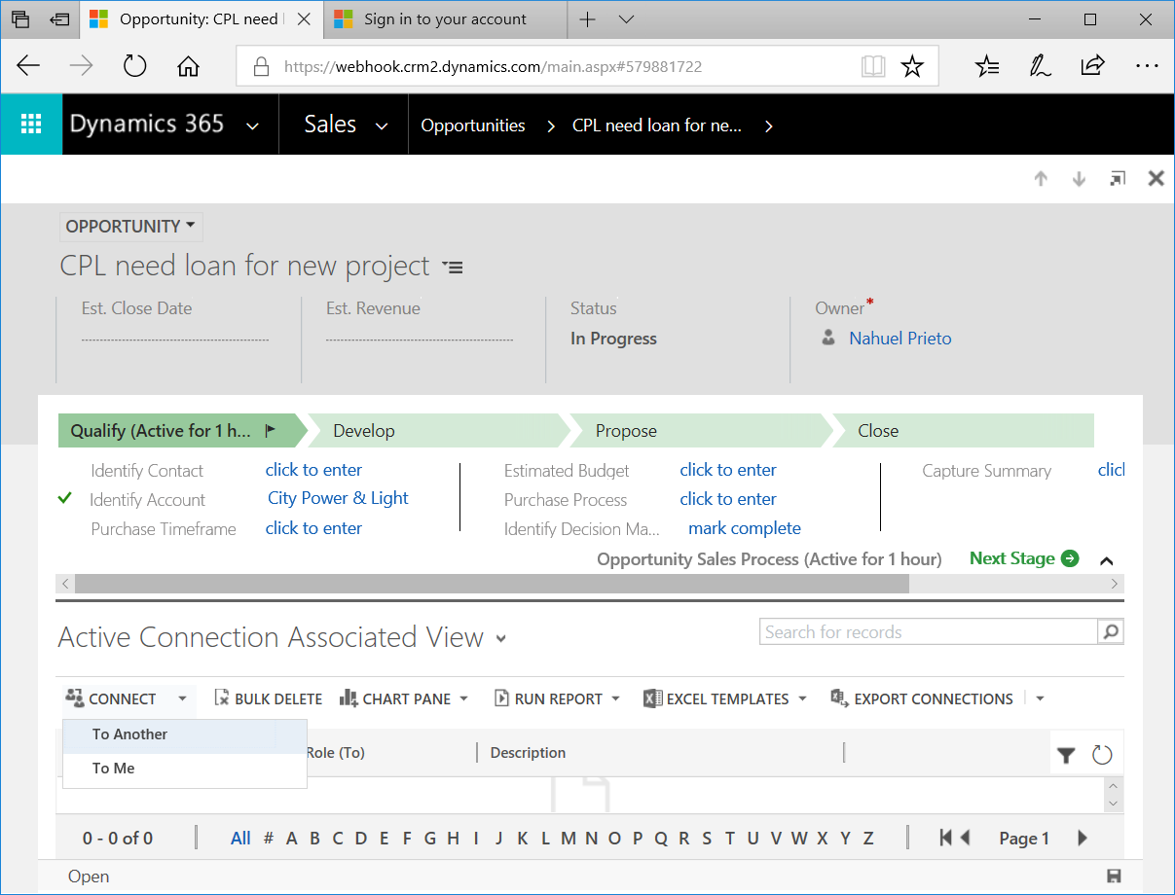
Create the connection
In the ribbon above the grid, select Connect > To Another

Slide 12
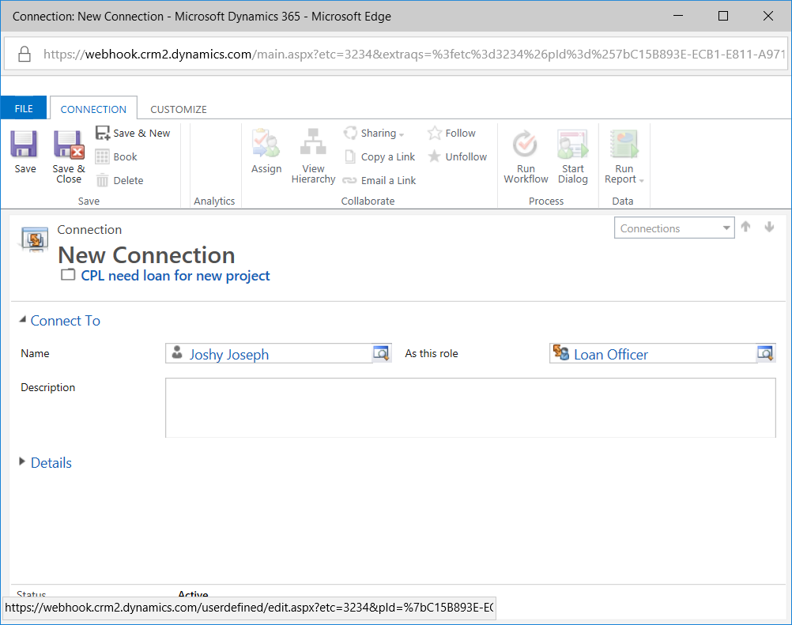
Save the connection
Select the user that you want to connect and the role you would like them to have. Then click Save & Close.

Slide 13
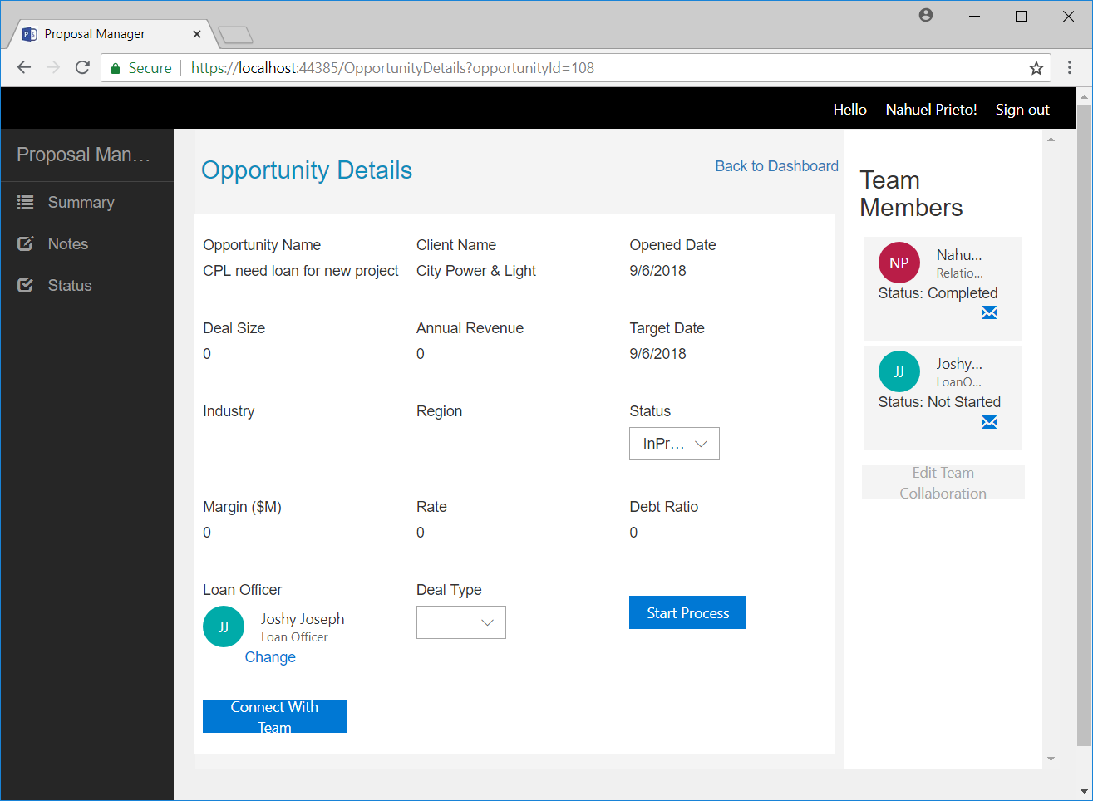
Visualize in Proposal Manager
You will now be able to see the member you added to the team from Proposal Manager.

Slide 14
Formal Proposal Upload
Upload the Formal Proposal template directly from Dynamics 365

Slide 15
Go to “Documents”
In the top navigation bar, go to “Documents”, as shown in the picture.

Slide 16
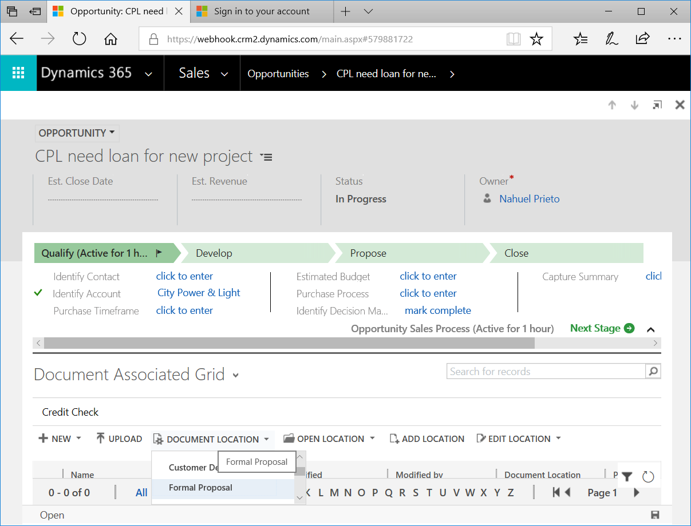
Go to “Formal Proposal”
In the ribbon above the document grid, change the current location to “Formal Proposal”, as shown in the image.

Slide 17
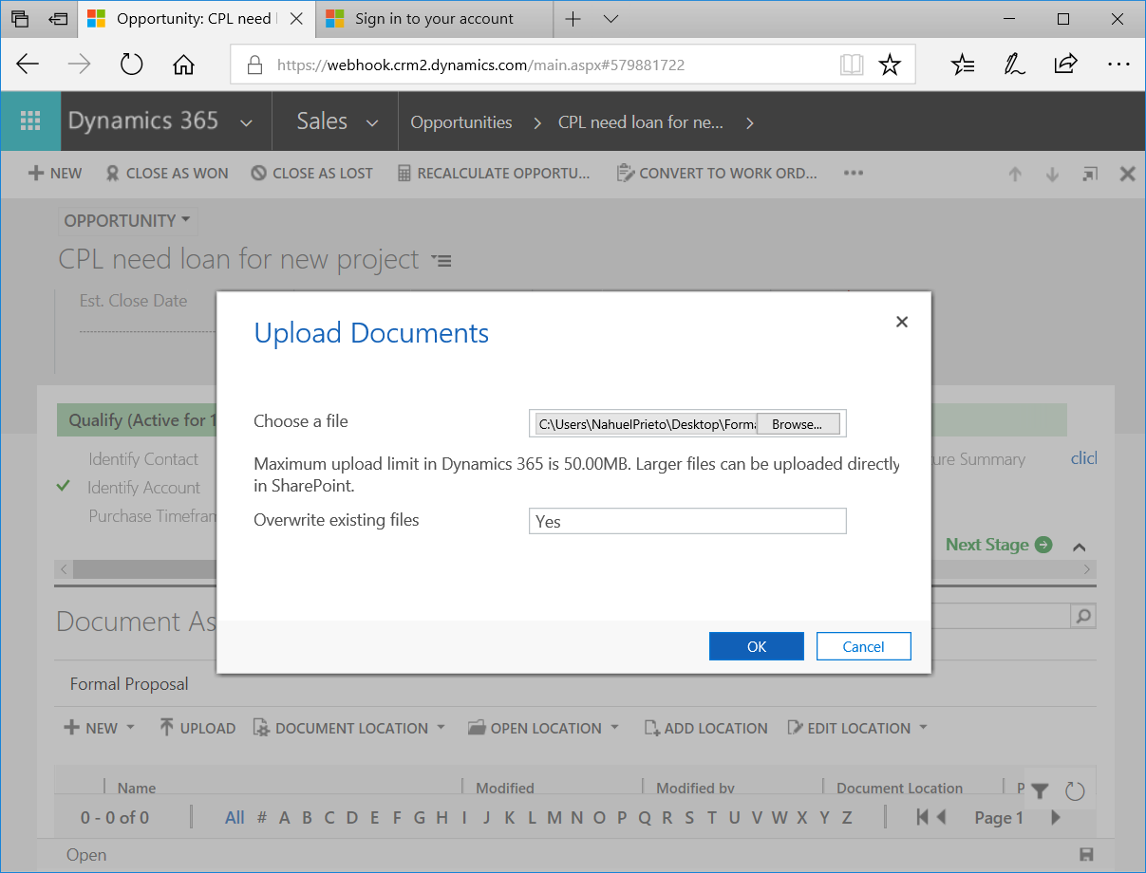
Upload the template
Upload the template you want for the formal proposal, and then click Ok

Slide 18
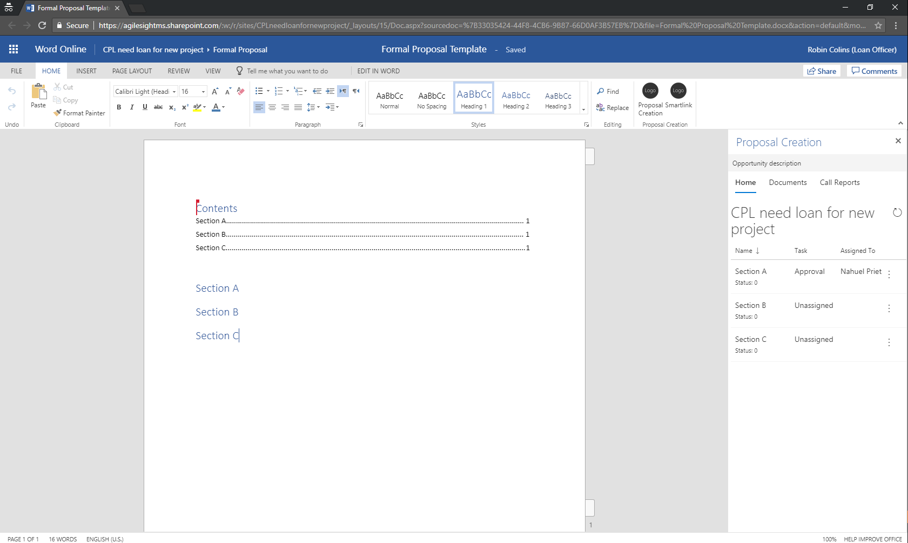
Visualize in Word
If you now open the document, you will see that its sections have been successfully picked up by Proposal Creation.

